Slide 1

Microwave Tracking Ground Station (MTGS)
Jared O’Shea
Christian Ogburn
Jusefs Saade
Clay Edwards
Ian Wolfe
Jordan West

Slide 2
Sprint 2 Demo Overview
SCRUM Progress
Changes to Product Vision and Functional Requirements
Hardware Design/Acquisition Progress
Software Development Progress
Current Obstacles
Our Plan Proceeding into Sprint 3

Slide 3
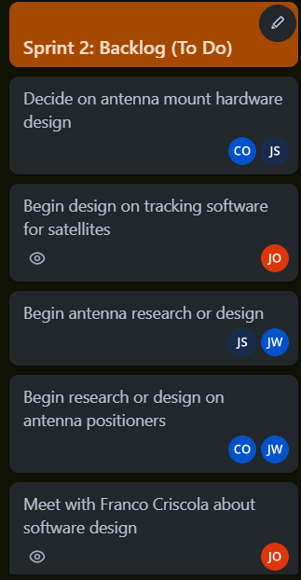
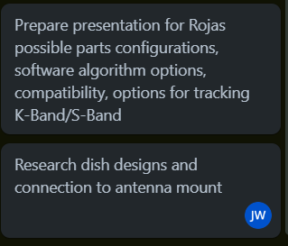
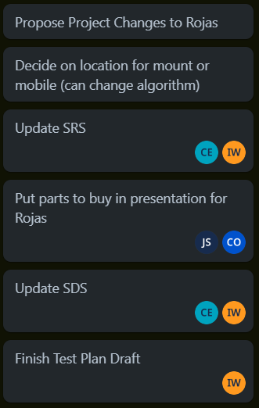
Scrum Progress
What we started with:

Slide 4
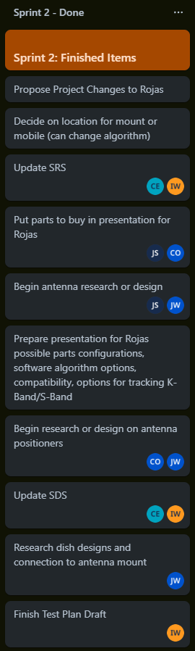
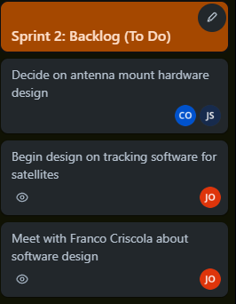
Scrum Progress
What was finished:
What is pushed to Sprint 3:

Slide 5
Scrum Goods & Bads
Good:
Assigning tasks was more effective in getting tasks done
Setting reasonable goals for the Sprint
Limited to what we could do this Sprint, but helped us focus on what could get done, rather than waiting
Bad:
Unable to do as many tasks as we would like due to limited time with customer
Forgot to update the board regularly and would move big chunks at once

Slide 6
Functional Requirements
Must receive a signal from, track, and continue to position towards a satellite
Our ground station must be able to perform in the K or Ku Band (10.9-27 GHz)
The ground station may be mobile or fixed
Construct a functioning prototype by Sprint 3, with a final product by the end of Spring 2024
Operate within a $5,000 budget
Create a physically smaller ground station system than the previous team's (dimensions unknown)

Slide 7
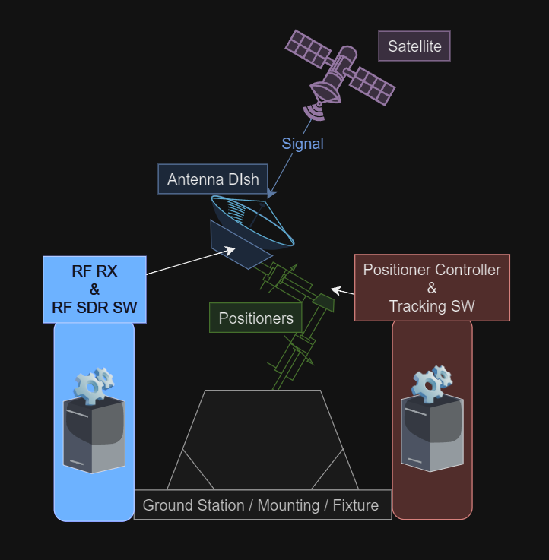
System Architecture

Slide 8
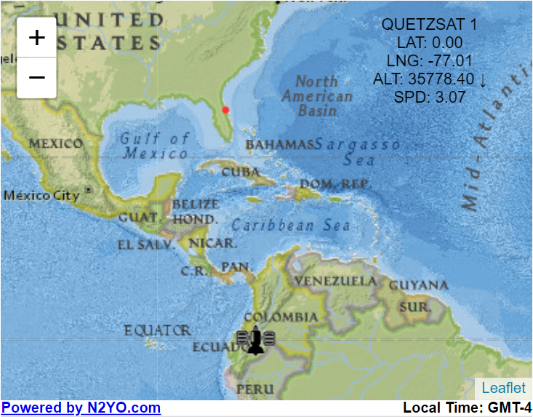
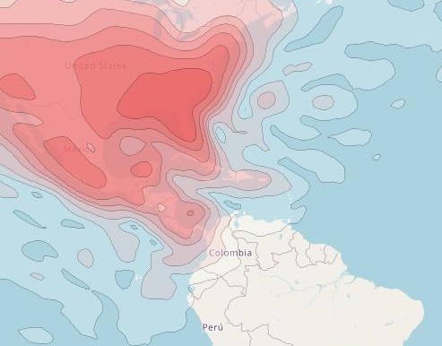
Satellite Option: Quetzsat 1
Operating Frequency: 12.224 - 12.676 GHz (Ku Band)
Channels: 13 (found tunable frequencies)
Transponders: 32 x Ku Band
Position: geostationary 22,300 miles over Ecuador (Always Testable at 77° W)
Two Line Element Set (TLE):
1 37826U 11054A 23306.44439176 -.00000241 00000-0 00000+0 0 9996
2 37826 0.0409 74.03530002785 171.8535 238.5802 1.00270738 44492
Source of the keplerian elements: AFSPC

Slide 9
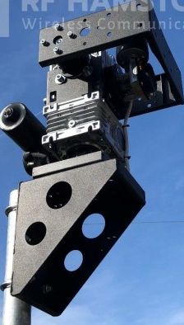
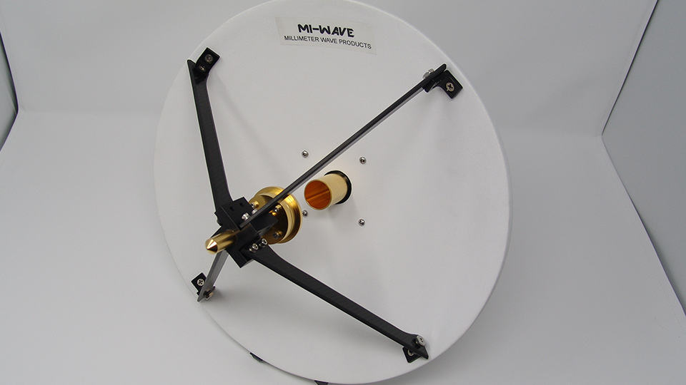
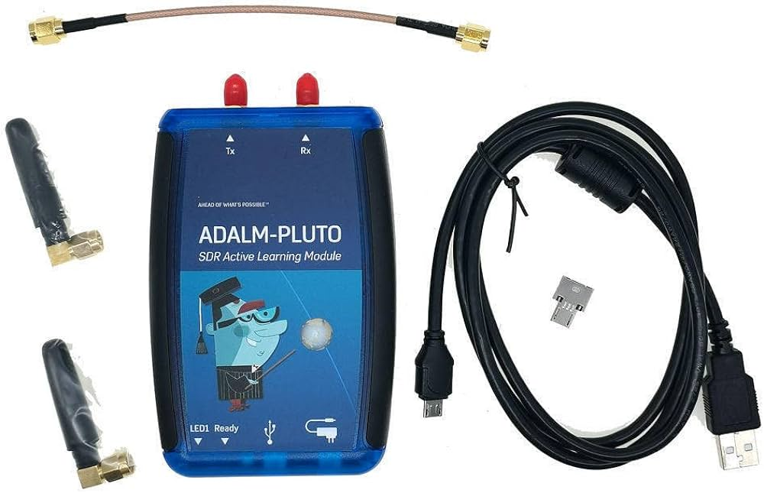
Hardware:
Positioners (would like to use SPX-01/HR)
Antenna - MI-WAVE (Millimeter Wave Product Inc)
SDR - ADALM PLUTO

Slide 10
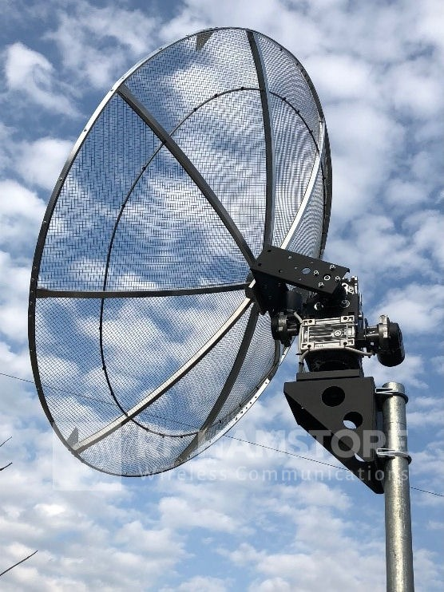
SPX-01/HR Positioner
(360º) Azimuth & (180º) Elevation Rotors
0.1875º Angle of Resolution
5.3º/s Rotation Speed
12.8kg (~28 lbs)
Max. Vertical Load: 30kg (~66 lbs)
Includes:
12V, 10/22A Power Supply
Controller – Built in USB tracking interface
Manual or Programmed Autonomous
TCP/IP Module for input application directly from internet
Pole-mast mounting bracket
Awaiting Purchase Approval

Slide 11
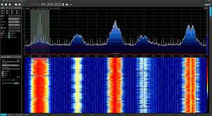
Software:
Open-source SDR Software
SDRSharp- compatible with PLUTO
Satellite Tracking Software
Depends on hardware we buy, may have a program that we have to write in
If not forced to use hardware-provided software, will use Maven in Eclipse with the OreKit library (Java)
> Input location of ground station
> Input keplerian elements of desired satellite
>Input start time and end time of tracking
> Track current time
> Calculate path points for time increments
> Move positioners toward satellite on time increments

Slide 12
Current Obstacles:
Finding another potential satellite to track and obtaining its Keplerian coordinates as well as its operating frequency to receive properly in K or Ku-Band.
Finding antenna dish diameter > 90cm operating in Ku or K band.
Finding Positioner and Dish Bracket to fit our needs.
Awaiting purchase approval

Slide 13
Retrospective:
What improved since last sprint?
Project direction is now focused towards development
Split sub teams has helped make speedier progress towards development
Organization of overall project has made tasks easier to complete and realize the goal of each one more clearly
We have gained knowledge of what we’ll be able to use to assemble our ground station and now have the access to acquire said components

